Slide 1
IBM Data Science Capstone Project: Landing Cost Prediction of the Falcon 9
BY: HERBERT BETT
DATE: 17/02/2023

Slide 2
TABLE OF CONTENTS
Executive Summary
Introduction
Methodology
Results
Conclusion
Appendix

Slide 3
INTRODUCTION
Normally, rockets are destroyed during their first space flight. Making rockets practically reusable has drawn interest and support from all over the world in an effort to dramatically lower the cost of space exploration.
Commercial aerospace firms like SpaceX have made major advancements in developing the technologies related to this phenomenon. Due to how reasonably priced rocket launches wind up being, this has proven to be convenient. This means that the cost can be calculated if it can be determined whether the first stage will land.

Slide 4
PROJECT OBJECTIVES
Build an interactive dashboard to extract actionable insights from the collected data
Extract data using the SpaceX REST API and populate it into a Pandas DataFrame.
Train a classification model to determine whether the first stage of the launch will land instead of using rocket science

Slide 5

METHODOLOGY

Slide 6






Methodology
Data Collection
EDA Using SQL
SQL is used to perform further data analysis.
Involved collecting data from the SpaceX API and Web Scraping.
Data Wrangling
Interactive Visual Analytics
Involving cleaning and Transforming the obtained data.
The Folium and Plotly Dash libraries are used to extract further insights.
EDA using Visuals
Predictive Analysis
Data was analyzed using the Seaborn and Matplotlib libraries.
Training of classification model to predict whether first stage will land.

Slide 7
Data Collection
The rocket launch data was collected from the SpaceX REST API using the requests library in Python
Web Scraping was also used to collect some of the data using the bs4 library in Python.
The obtained data was then populated into a Pandas dataframe.
Subsequently, the data was cleaned with the exception of the Landing Pad column since the null values represented a situation when the identified pad was not utilized during the launch.

Slide 8
Dataset Description
Key Features | Description
Booster Version | Version of booster i.e. F9 B5 B1049.4
Launch Site | Name of site where rocket launch took place.
Payload Mass | Mass in kilograms of payload.
Orbit Type | The path to be taken in space.
Cores | Identification of core used
Outcome | Result after launch i.e. Success or Failure.

Slide 9
Data Wrangling
The Data Wrangling process consisted of 3 steps :
Exploratory Data Analysis
Calculation of key summary characteristics such as the no. of launches per launch site , the number and occurrence of each orbit type and mission outcome per orbit type .
Finally, an outcome label was created using one-hot encoding.
Exploratory Data Analysis
Summary characteristics
Creation of landing outcome label

Slide 10
Exploratory Data Analysis using Visualization
In this section, the seaborn and Matplotlib libraries were used to generate graphs and plots that were used to extract further insights from the dataset.
Scatter plots were used mainly to identify relationships between the predictor variables and the response variable or to observe whether there was any correlation between the predictor variables.
Some of the visualizations were also used to capture any patterns in the data.

Slide 11
Exploratory Data Analysis using SQL
SQL (Structured Query Language) was used to query the data that was contained in a SQLite database.
The following are some of the queries that were performed on the data:
Names of the unique launch sites in the space mission.
Top 5 launch sites whose name begin with the string 'CCA’.
Total payload mass carried by boosters launched by NASA (CRS) .
Average payload mass carried by booster version F9 v1.1.

Slide 12
Interactive Visual Analytics using Folium
Interactive visual analytics add a different dimension when it comes to extracting actionable insights from data.
In this case, the Folium library was used to create interactive maps that were used to clearly show the locations of the various launch sites relative to key infrastructure such as roads or the proximity of the same sites to various landmarks such as coastlines.
This was done using markers, clusters, polylines , icons among other features.

Slide 13
Interactive Visual Analytics using Plotly Dash
The Dash library is used to create a dashboard app that consists of various features such as a dropdown for the various launch sites and a range slider that was used to obtain the successful and unsuccessful launches in various payload ranges by booster version.
The dashboard app consisted of two sections that would display a pie chart and a scatter plot respectively based on the selections from the dropdown and range slider.

Slide 14
Predictive Analysis
This is the final and key step in the process and is used to determine whether the first stage of the launch will land.
Since we want to predict the outcome of a particular activity, classification models were used to predict the launch outcome.
The following were the classification models used:
Logistic Regression
Support Vector Machines
K Nearest Neighbors
Decision Trees

Slide 15
Predictive Analysis Process
Variable Transformation by feature scaling
Splitting of the dataset into train and test sets.
Initialization of the classification models and their parameters.
Choose the best classification model .
Performance metrics for the best models after tuning
Hyperparameter tuning for each model to obtain the best parameters.

Slide 16

EDA RESULTS

Slide 17
Exploratory Data Analysis Results
There were four distinct launch sites used in Falcon 9 launches.
The average payload mass of rockets using the F9 V1.1 booster version was 2928.4 kg.
The first successful ground pad landing took place nearly 8 years since the first launch.
Almost 99% of the missions were successful.
The number of successful landing outcomes increased from 2013 onwards.
Most Falcon 9 booster versions were successful at landing in drone ships having payload masses above the average.
Most of the launch sites were located at a close proximity to the coastlines and far away from critical infrastructure

Slide 18
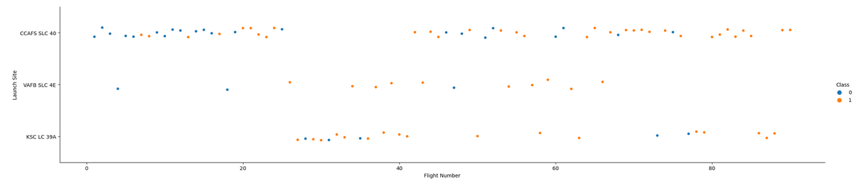
EDA USING VISUALIZATION RESULTS
Launch Site vs Flight Number
Most launches take place at the CCAFS SLC 40 most of which are successful while the VAFB SLC 4E has the least amount of launches most of which are successful.

Slide 19
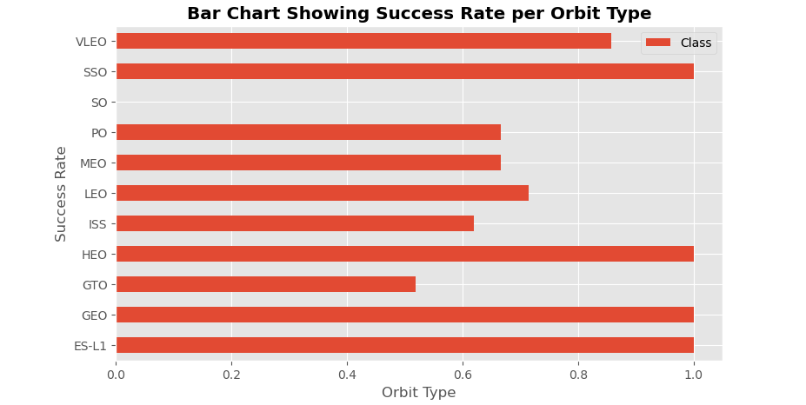
Success Rate per Orbit type
SS0, HEO, GEO and ES-L1 have the highest success rate when they are used during the launches.
The SO orbit type has a zero success rate when used for Falcon 9 launches.

Slide 20
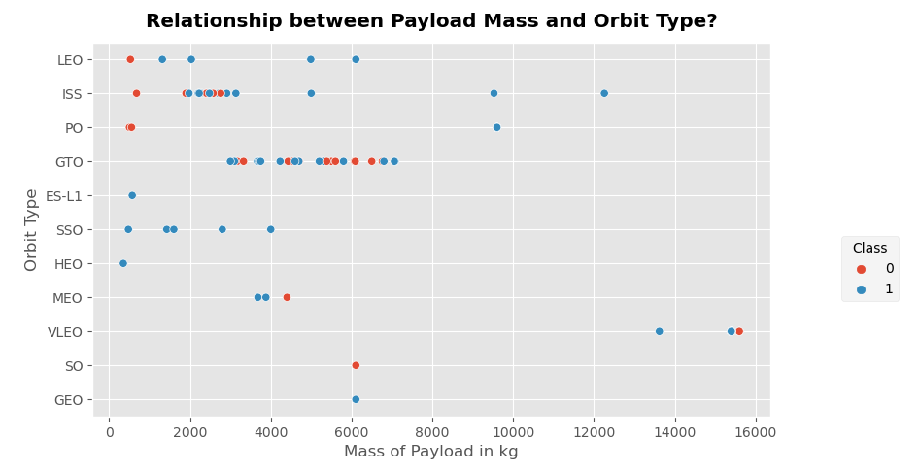
Orbit Type vs Payload Mass
The payload mass range for rockets launched in the GTO orbit is 2000 – 8000 kg.
The VLEO orbit type is used when rockets contain heavy payloads.
The ES-L1 and HEO orbit types are the least utilized orbit types.

Slide 21
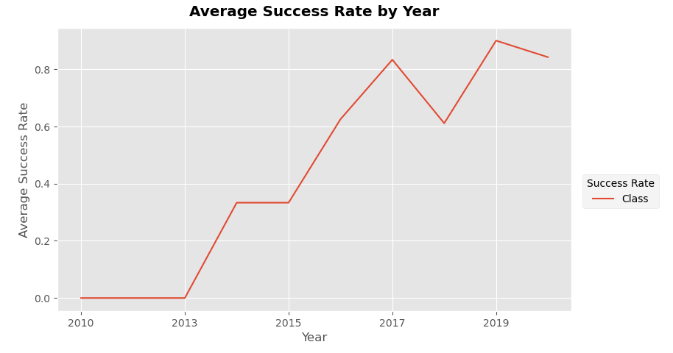
Average Success Rate by Year
The average success rate of the rocket launches increases drastically after 2013 as shown by the sharp increase in slope of the graph.
The stagnation between 2010 – 2013 can be attributed to the various launch failures when SpaceX started out experiments on reusable rockets.
.

Slide 22
EDA USING SQL RESULTS
Launch Sites Used
The launch sites that were mainly used include:
CCAFS LC-40
CCAFS SLC-40
VAFB SLC-4E
KSC LC-39A
Launch Site
CCAFS LC-40
VAFB SLC-4E
KSC LC-39A
CCAFS SLC-40

Slide 23
EDA USING SQL RESULTS
Payload Mass carried by NASA(CRS) launches
The total payload mass carried by NASA (CRS) is 45596 kg .
Customer | Total mass
NASA (CRS) | 45596

Slide 24
EDA USING SQL RESULTS
Average Payload Mass carried by F9 V1.1 boosters
The average payload mass carried by F9 v1.1 boosters is 2928.4 kg
Booster Version | Average mass
F9 v1.1 | 2928.4

Slide 25
EDA USING SQL RESULTS
First Successful landing on a Ground Pad
The first successful ground pad landing occurred on 01-05-2017
MIN(“Date”)
01-05-2017

Slide 26
EDA USING SQL RESULTS
Boosters with a successful landing outcome on a drone ship and a Payload mass between 4000 – 6000 kg
The booster versions with a successful landing outcome on a drone ship and a payload mass between 4000 and 6000 kg are as shown below.
Booster Version
F9 FT B1022
F9 FT B1026
F9 FT B1021.2
F9 FT B1031.2

Slide 27
EDA USING SQL RESULTS
Proportion of successes and failures in landing outcome
The proportion of successful and unsuccessful landing outcomes is as shown below:
Mission Outcome | Total outcomes
Failure (in flight) | 1
Success | 99
Success (payload status unclear). | 1

Slide 28
EDA USING SQL RESULTS
Booster Versions that carry the maximum Payload mass
The booster versions that carry the maximum payload mass recorded are as shown below:
Booster Version
F9 B5 B1048.4
F9 B5 B1049.4
F9 B5 B1051.3
F9 B5 B1056.4
F9 B5 B1048.5
F9 B5 B1051.4
Booster Version
F9 B5 B1049.5
F9 B5 B1060.2
F9 B5 B1058.3
F9 B5 B1051.6
F9 B5 B1060.3
F9 B5 B1049.7

Slide 29
EDA USING SQL RESULTS
Booster Versions that failed to land on a drone ship in 2015
The launch sites where there were failed landings on drone ships and their booster versions are shown below:
Booster Version | Launch Site
F9 v1.1 B1012 | CCAFS LC-40
F9 v1.1 B1015 | CCAFS LC-40

Slide 30
EDA USING SQL RESULTS
Total possible outcomes ranked by count between 04-06-2010 and 20-03-2017
Ranking the all the possible outcomes by count between 04-06-2010 and 20-03-2017 yields:
Landing Outcome | Total count
Success | 20
No attempt | 11
Success (drone ship) | 8
Success (ground pad) | 6
Failure (drone ship) | 4
Failure | 3
Controlled (ocean) | 3
Failure (parachute) | 2

Slide 31

INTERACTIVE VISUAL ANALYTICS USING FOLIUM

Slide 32
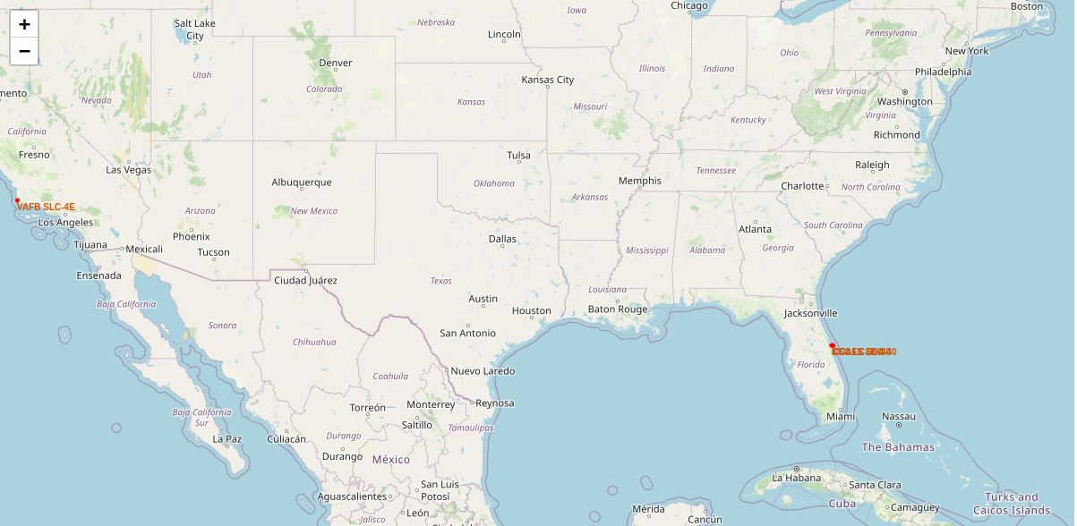
General location of launch sites
All the launch sites are located at or near coastlines as shown above to ensure safety of people and avoidance of critical infrastructure damage.

Slide 33
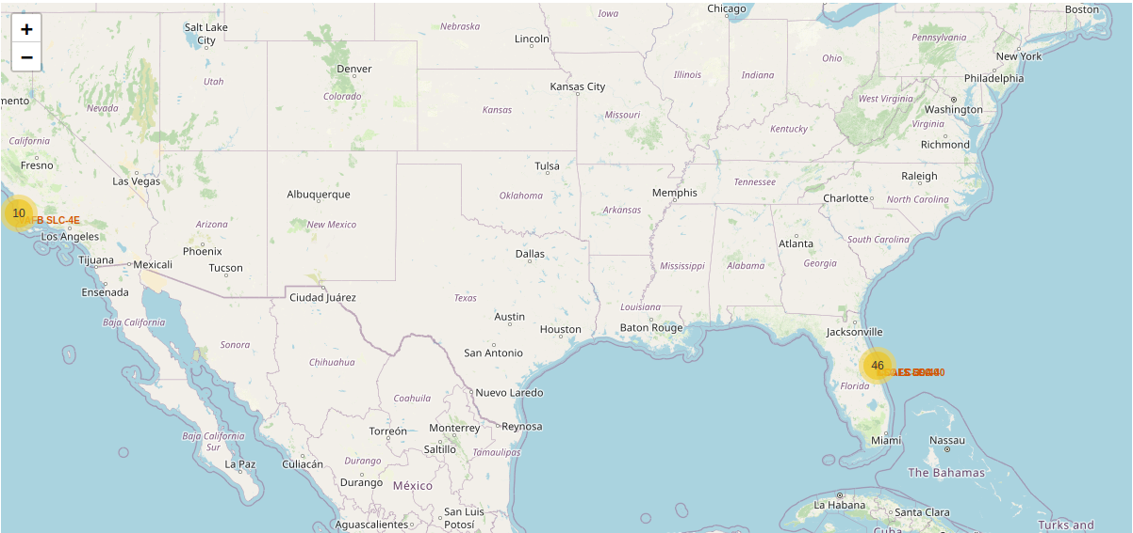
Upon further analysis, it is observed that most of the launch sites are located at or near the coastline of Florida (46) while the rest are found on the coast of California (10) as shown below.

Slide 34
Proximity analysis on the Launch Sites.
Proximity analysis was carried out by computing the distance between the launch sites and critical infrastructure such as roads , railways and buildings using the haversine distance and drawing a line between the launch sites and the various structures.
Upon performing this computation and visualizing it on the map, it can be concluded that the launch sites are located as far as possible from populated areas and key infrastructure as said earlier.
An example of this can be seen on the next slide.

Slide 35
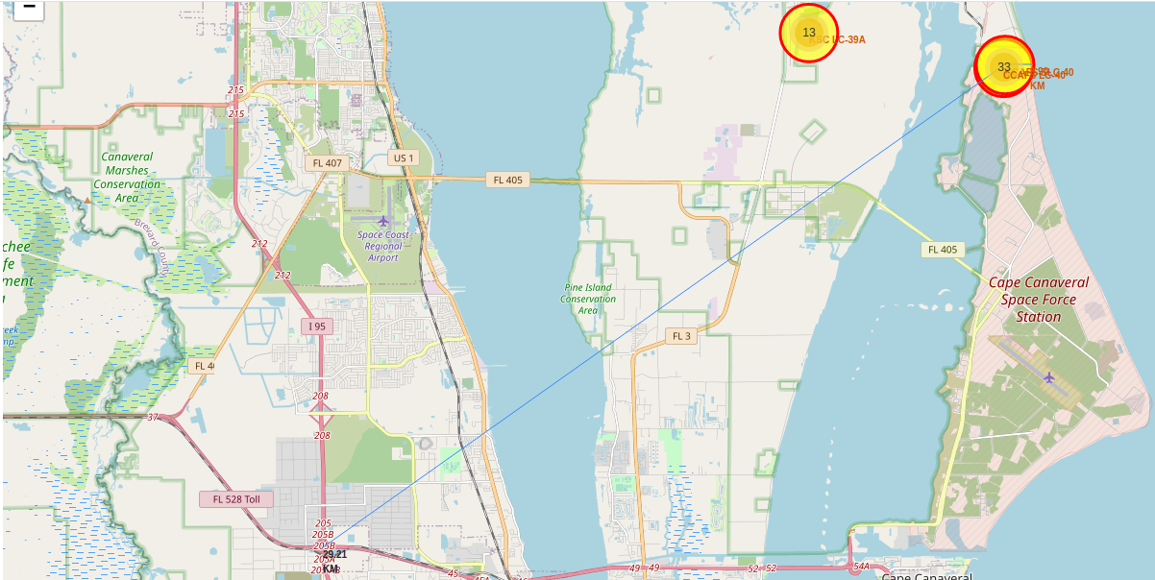
From the above graphic, it can be seen that the launch sites are located as far as possible from populated areas.

Slide 36
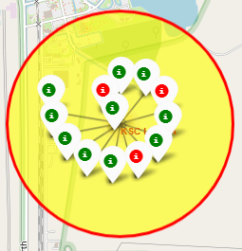
Markers and icons with special color coding were used to represent the landing outcomes in the various launch sites with green and red used to show successful and unsuccessful landing outcomes respectively as shown below.

Slide 37

INTERACTIVE VISUAL ANALYTICS USING PLOTLY DASH

Slide 38
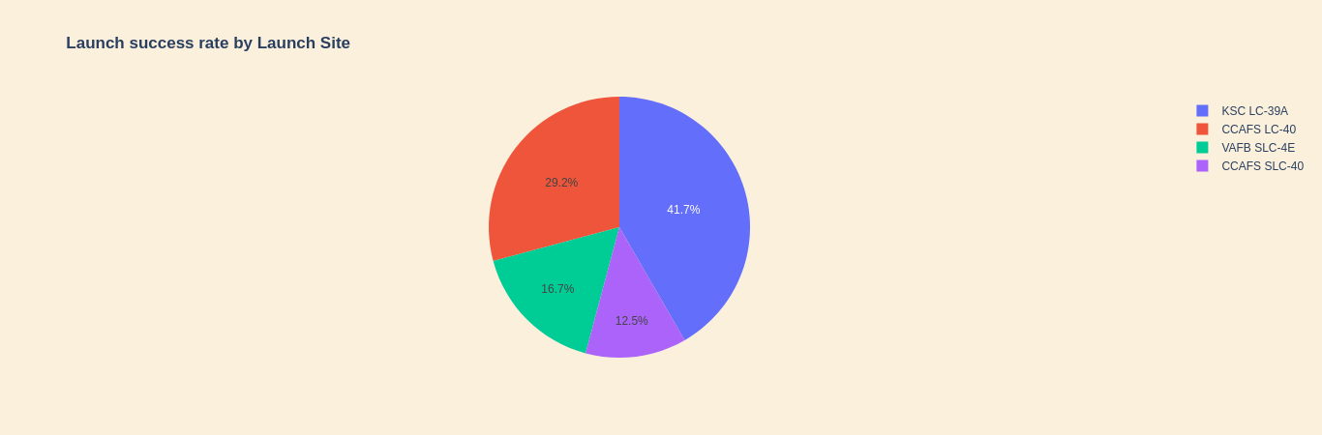
Launch Success Rate by Launch Site
The KSC LC-39A launch site accounts for 41.7% of the successful outcomes achieved in all sites

Slide 39
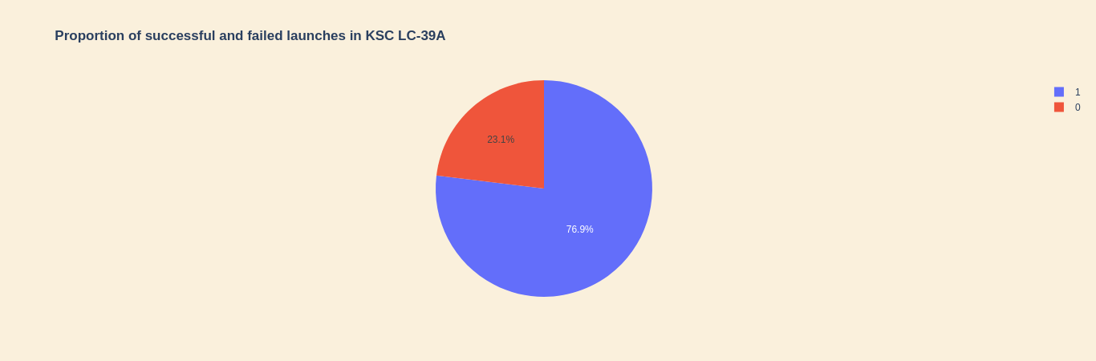
The same launch site has a success rate of 76.9% in its launches as shown in the pie chart below:

Slide 40
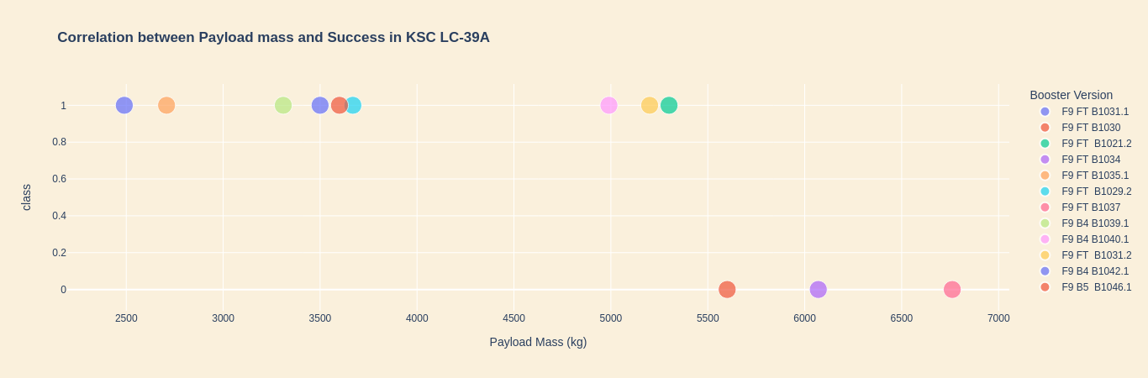
Scatter plot of Outcome against Payload mass
From the scatter plot for launch site KSC LC-39A, it can be concluded that rockets launched from this location succeed when the payload mass is between 0 – 5500 kg

Slide 41
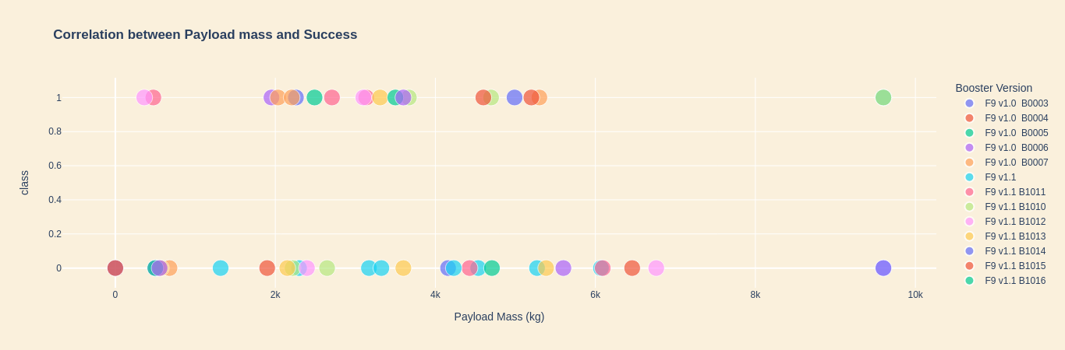
From the scatter plot for all sites, most of the launching outcomes were unsuccessful as in the figure below.

Slide 42

PREDICTIVE ANALYSIS

Slide 43
After exhaustive analysis of the dataset, predictive analysis was carried out to find out whether the first stage will land.
The predictive analysis process was as outlined in the predictive analysis slide of the methodology section.
The said process was applied using four classification algorithms namely:
Logistic Regression
Support Vector Machines
K-nearest neighbors
Decision Trees

Slide 44
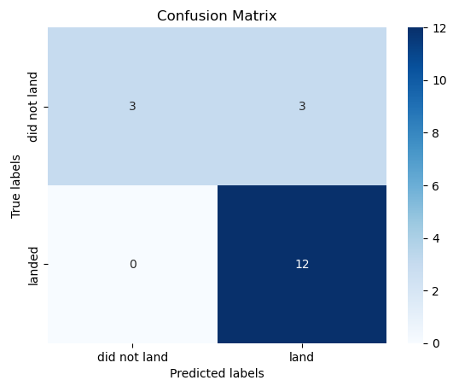
Logistic Regression
Model features and parameters:
Model: LogisticRegression()
Solver: lbfgs
Penalty: L2 (Ridge)
Regularization strength, C : [0.01, 0.1, 1]
Validation score | Test score
0.8464 | 0.8333

Slide 45
Support Vector Machines
Model features and parameters:
Model: SVC()
Kernels: [linear, poly, sigmoid, rbf]
Gamma: np.logspace(-3, 3, 5)
Regularization strength, C: np.logspace(-3, 3, 5)
Validation score | Test score
0.8482 | 0.8333

Slide 46
Decision Tree
Model features and parameters:
Feature / Parameter | Value
Model | DecisionTreeClassifier
Max features | [‘auto’, ‘sqrt’]
Splitter | [‘best’, ‘random’]
Criterion | [‘entropy’, ‘gini’]
Min samples leaf | (1, 2, 4)
Min samples split | (2, 5, 10)
Max_depth | [2*n for n in range(1,10) ]
Validation score | Test score
0.8893 | 0.9444

Slide 47
K-Nearest Neighbors
Model features and parameters:
Model: KNeighborsClassifier()
n_neighbors: range(1,11)
Algorithm: [‘ball_tree’, ‘kd_tree’, ‘auto’, ‘brute’]
p: [1, 2]
Validation score | Test score
0.8482 | 0.8333

Slide 48
Based on the performance metrics as shown on the table, it can be concluded that:
The Logistic Regression, Support Vector Machine and K-Nearest Neighbors models perform worse on the test set since all their test accuracy scores are lower than the validation score.
The Decision Tree classification model performs exceptionally well on the test since its test score is significantly larger than its validation score and thus one is inclined to choose it.
The final test scores are shown below:
Estimator | Test score
Decision Tree Classifier | 0.9444
Logistic Regression | 0.8333
Support Vector Machines | 0.8333
K-Nearest Neighbors | 0.8333

Slide 49
Conclusions
Based on the visual analysis carried out, the most successful launch site is the KSC LC-39A.
From the maps generated using Folium, almost all launch sites are located at or near coastlines to prevent damage of critical infrastructure such as roads, railways and buildings caused by debris during launch.
The Decision Tree Classifier model was identified as the best model to predict whether the first stage would land.
The Florida coastline accounts for nearly all the launch sites associated with the Falcon 9.

Slide 50
THANK YOU

